Slide 1

Shell Programming Lecture # 6
Dr. Muhammad Bilal Qureshi
m.qureshi@centralasian.uz
Central Asian University, Tashkent, Uzbekistan

Slide 2
Source
Textbook:
Beginning Linux Programming 4th Edition by Neil Matthew

Slide 3
Contents
Shell Syntax
Variable
Conditions
Control Structures (if, else, elif, for, while, until, case, list- AND & OR list)
Functions
Commands

Slide 4
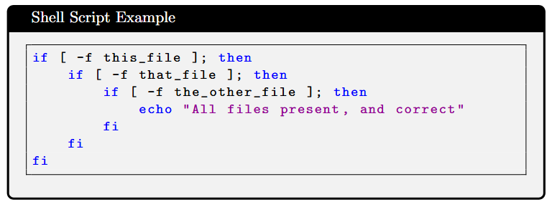
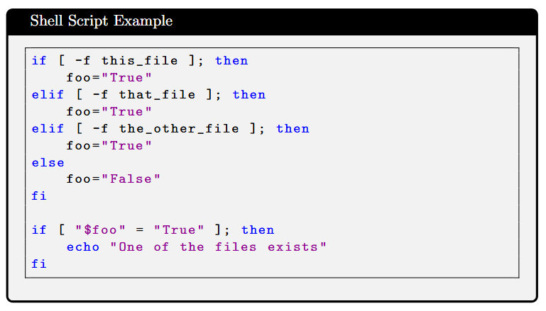
Lists
Sometimes you want to connect commands in a series. For instance, you may want several different conditions to be met before you execute a statement:
Or you might want at least one of a series of conditions to be true:
The shell has a special pair of constructs for dealing with lists of commands: the AND list and the OR list. These are often used together.

Slide 5
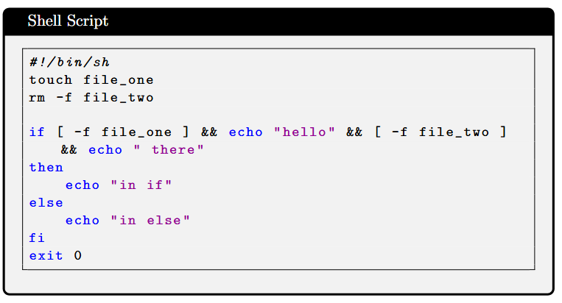
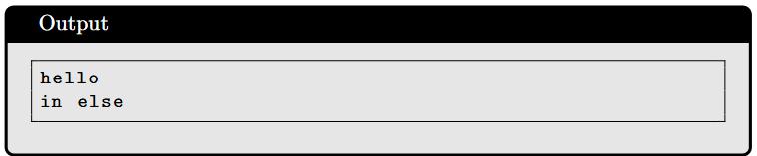
AND List
In the following script, you touch file_one (to check whether it exists and create it if it doesn’t) and then remove file_two. Then the AND list tests for the existence of each of the files and echoes some text in between.
The AND list construct enables you to execute a series of commands, executing the next command only if all the previous commands have succeeded. The syntax is:
statement1 && statement2 && statement3 && ...
Each statement is executed independently, enabling you to mix many different commands in a single list, as the following script shows. The AND list as a whole succeeds if all commands are executed successfully, but it fails otherwise.

Slide 6
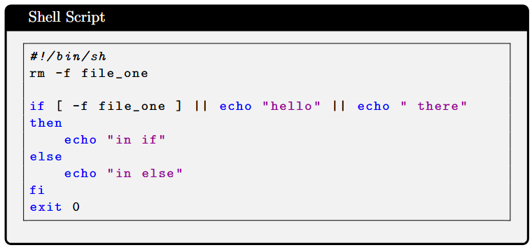
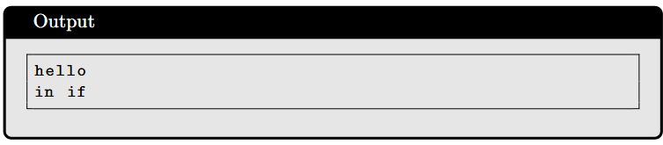
OR List
The OR list construct enables us to execute a series of commands until one succeeds, and then not execute any more. The syntax is as follows:
statement1 || statement2 || statement3 || ...
Starting at the left, each statement is executed. If it returns false, then the next statement to the right is executed. This continues until a statement returns true, at which point no more statements are executed.
The || list is very similar to the && list, except that the rule for executing the next statement is that the previous statement must fail.

Slide 7

AND-OR List
Combining these two constructs is a logician’s heaven and is usually known as short circuit evaluation. Try out the following:
[ -f file_one ] && command for true || command for false
This will execute the first command if the test succeeds and the second command otherwise. It’s always best to experiment with these more unusual lists, and in general you should use braces to force the order of evaluation.

Slide 8
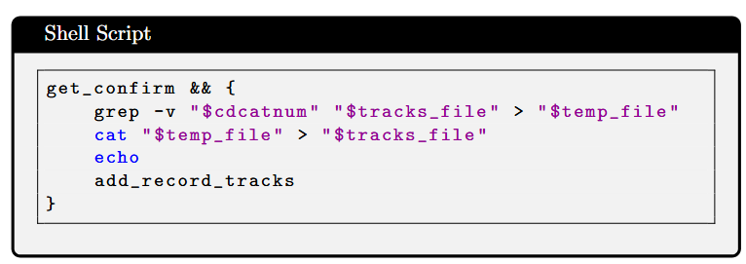
Statement Blocks
If you want to use multiple statements in a place where only one is allowed, such as in an AND or OR list, you can do so by enclosing them in braces {} to make a statement

Slide 9
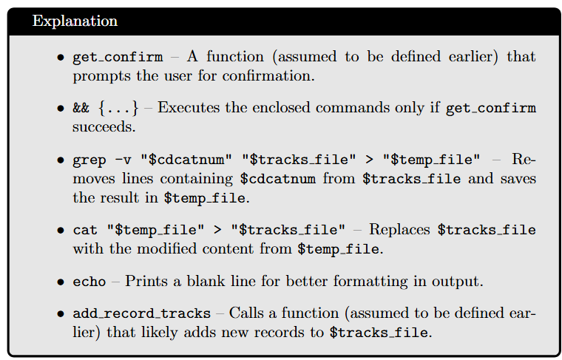

Slide 10
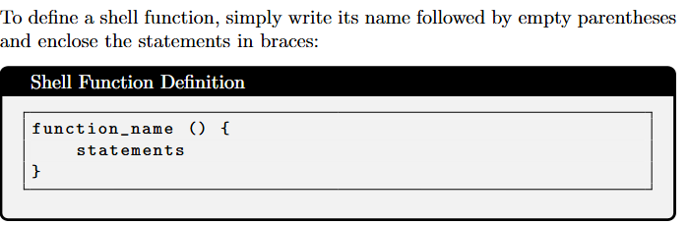
Functions in Shell Scripting
Why Use Functions?
Improve code structure and readability.
Promote code reuse and modularity.
Simplify debugging by isolating logic.

Slide 11
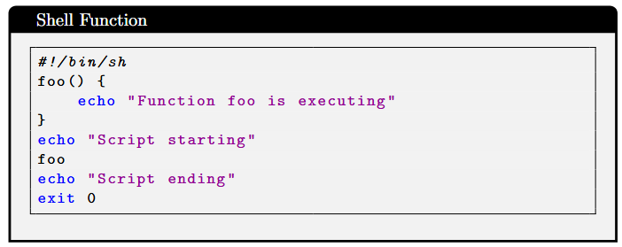
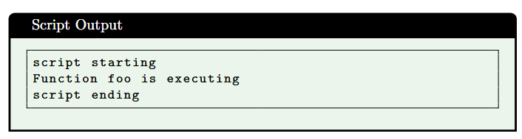
A simple Function
You must always define a function before you can invoke it, no declaration in shell.
When a function is invoked, the positional parameters to the script, $*, $@, $#, $1, $2, and so on are replaced by the parameters to the function.
That’s how you read the parameters passed to the function. When the function finishes, they are restored to their previous values.

Slide 12
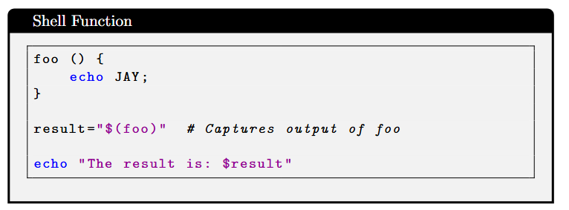
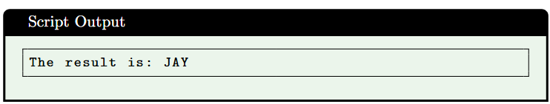
Function (Cont..)
You can make functions return numeric values using the return command.
The usual way to make functions return strings is for the function to store the string in a variable, which can then be used after the function finishes.
Alternatively, you can echo a string and catch the result, like this:
Note that you can declare local variables within shell functions by using the local keyword. The variable is then only in scope within the function.
Notes:
Semicolon for multiple commands inside single line it will terminate echo
Echo output will be captured in substituted in result

Slide 13
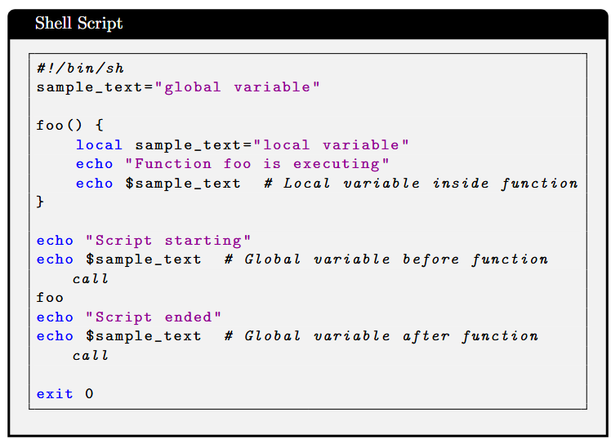
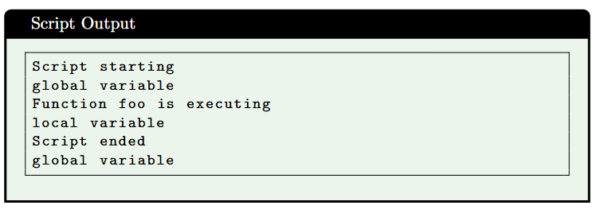
Function (Cont..)
If a local variable has the same name as a global variable, it overlays that variable, but only within the function. For example, you can make the following changes to the preceding script to see this in action.
Notes:
In the absence of a return command specifying a return value, a function returns the exit status of the
last command executed inside the function

Slide 14
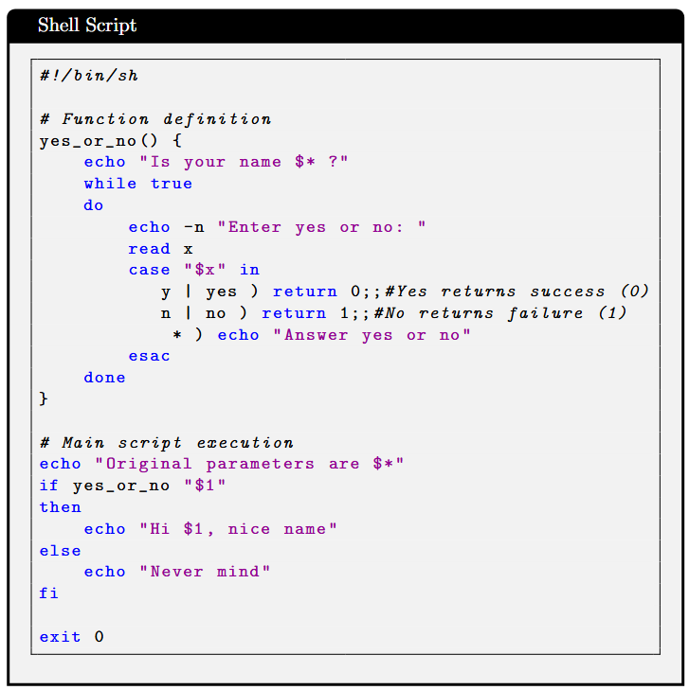
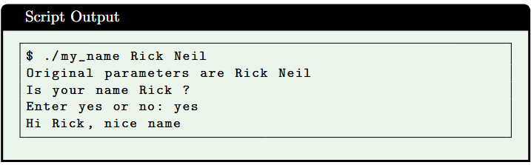
Returning a value
This script shows how parameters to a function are passed and how functions can return a true or false result.
Notes:
yes_or_no "$1“
status=$?
# Capture return value (0 for yes, 1 for no)
if [ $status -eq 0 ]; then
echo "Hi $1, nice name"
else echo "Never mind"
fi

Slide 15
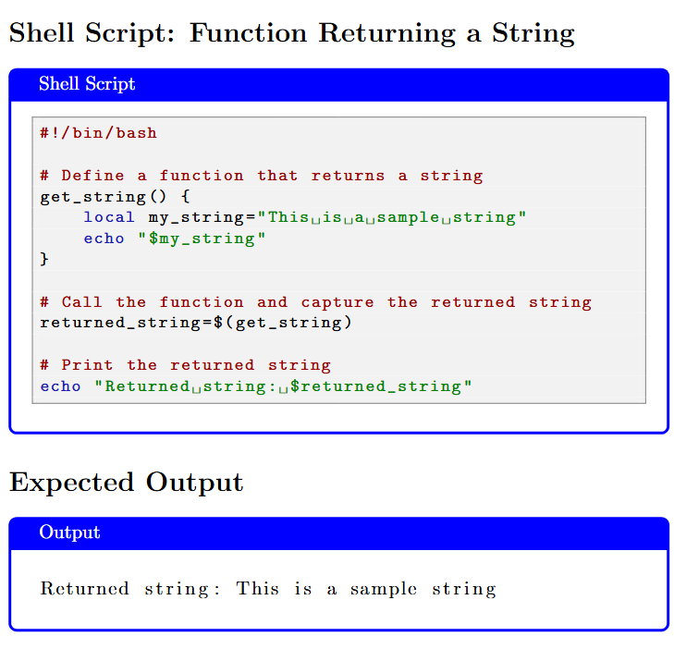
Function Returning a String

Slide 16
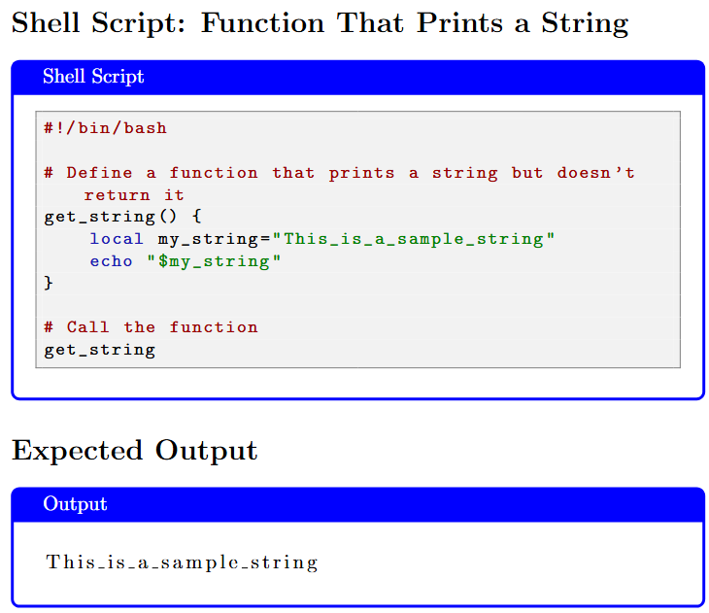
Same Function with no return

Slide 17
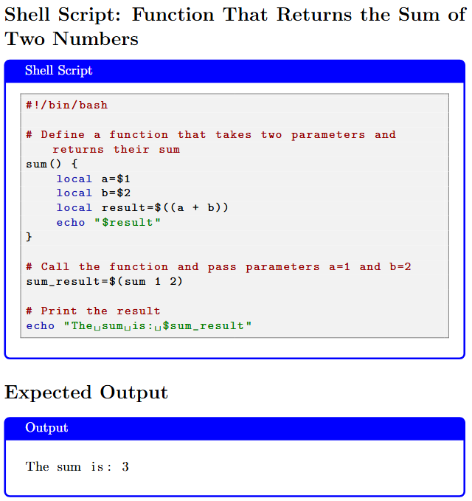
Positional Parameter Example

Slide 18
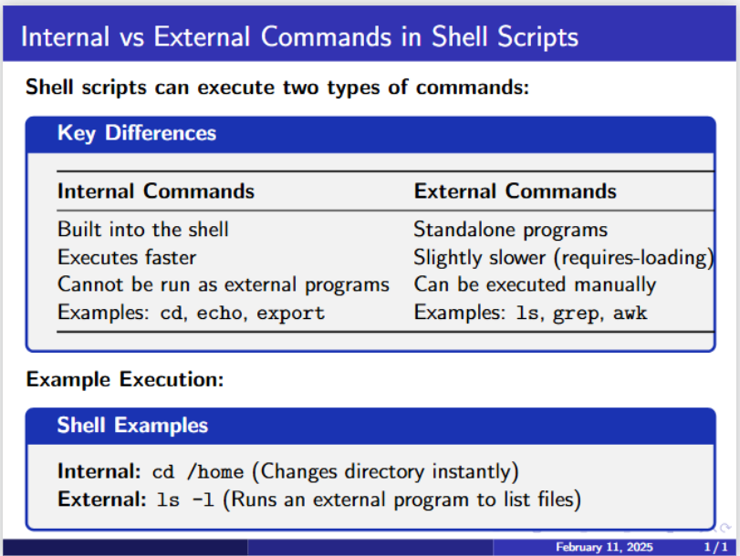
Commands (type cd) to check its type)
Notes:
type cd
type –a ls
type –a grep
Internal Commands : Commands which are built into the shell. For all the shell built-in commands, execution of the same is fast in the sense that the shell doesn’t have to search the given path for them in the PATH variable, and also no process needs to be spawned for executing it. Examples: source, cd, fg, etc.
External Commands : Commands which aren’t built into the shell. When an external command has to be executed, the shell looks for its path given in the PATH variable, and also a new process has to be spawned and the command gets executed. They are usually located in /bin or /usr/bin. For example, when you execute the “cat” command, which usually is at /usr/bin, the executable /usr/bin/cat gets executed. Examples: ls, cat etc.

Slide 19
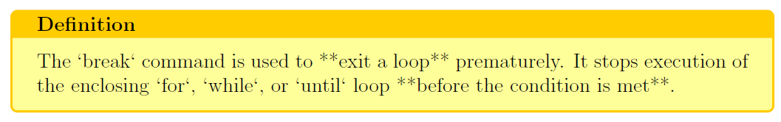
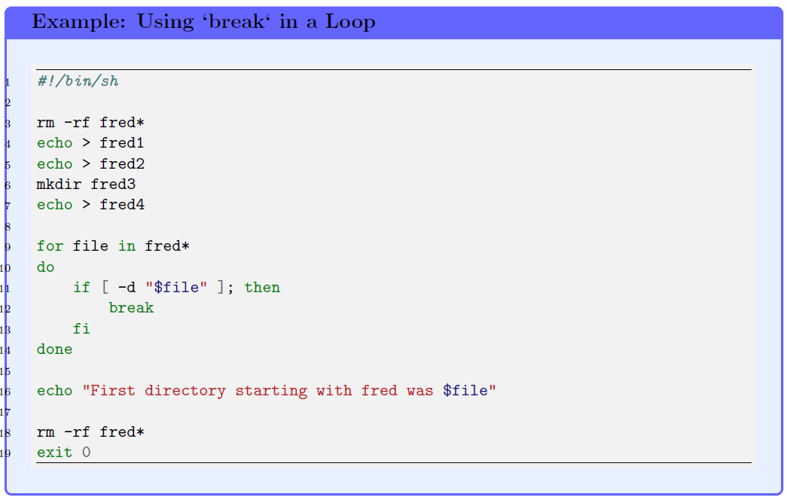
Break Command
Notes:
ls -d fred* (to check what will be deleted)

Slide 20
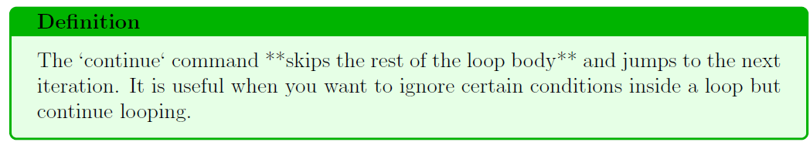
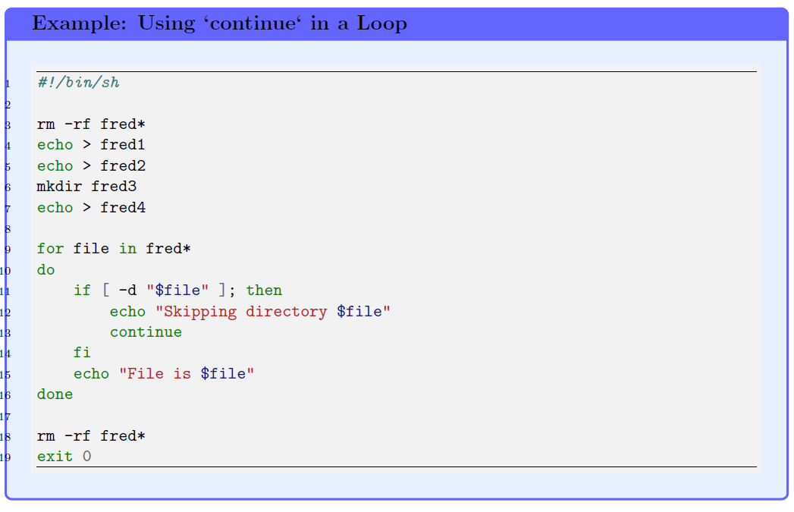
Continue Command

Slide 21
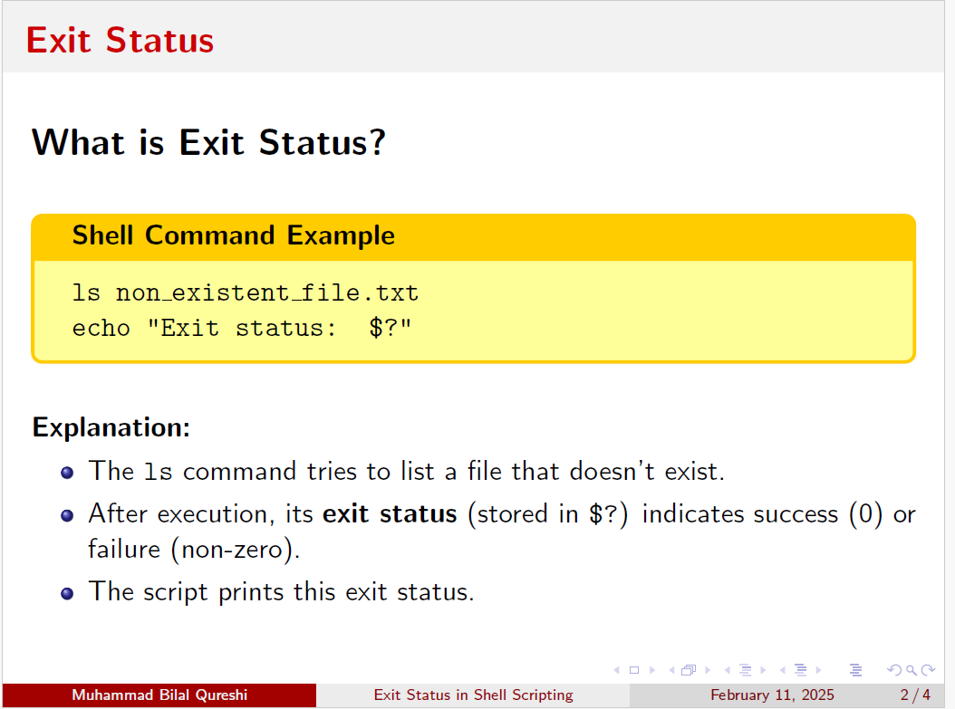

Slide 22
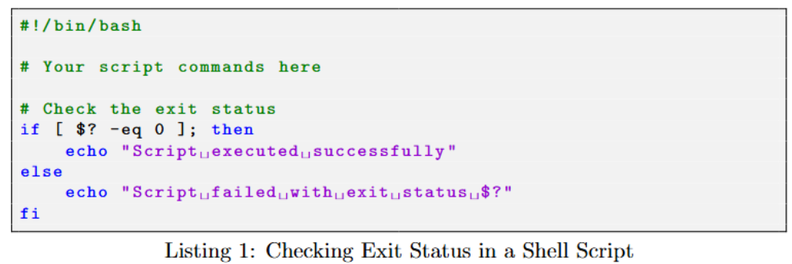
A way to find out the exit status of script

Slide 23
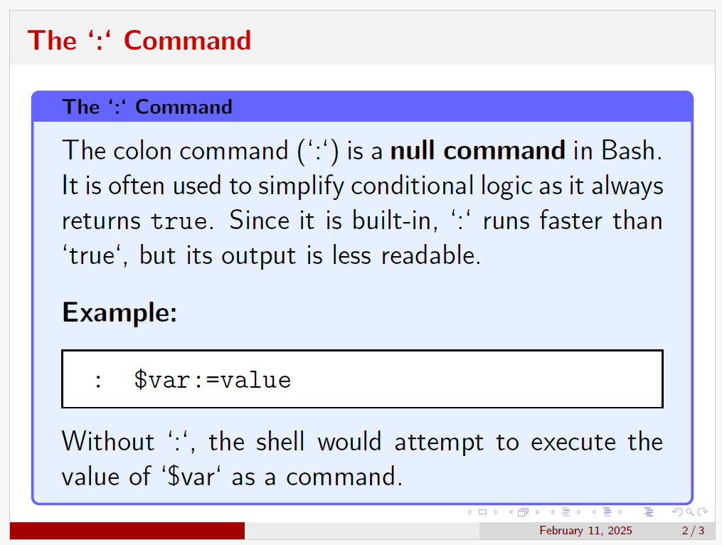
Notes:
#!/bin/bash
# If $fruit is unset or null, set it to "apple"
: ${fruit:=apple}
echo "I like $fruit“

Slide 24
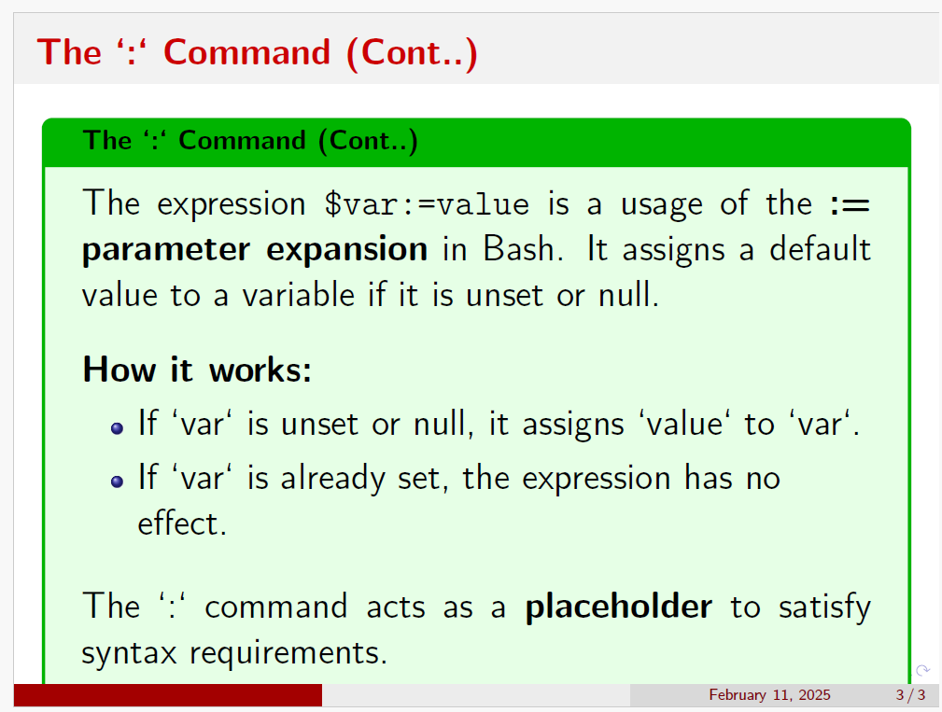

Slide 25
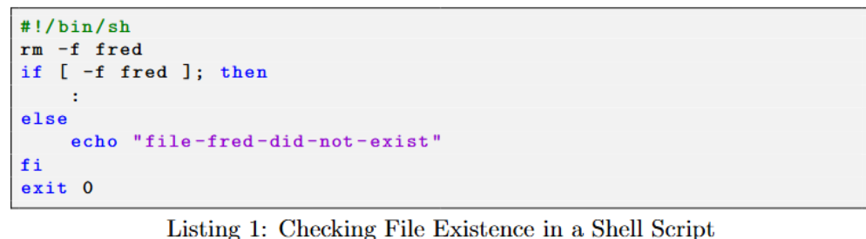
Example

Slide 26
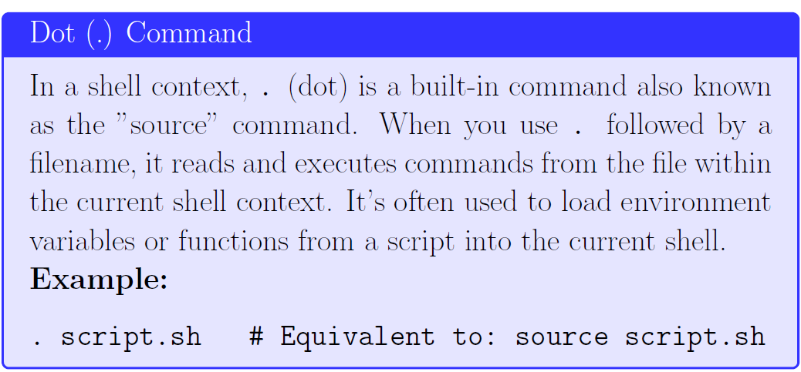
Understanding “.” “./” and “. ./” in Shell

Slide 27
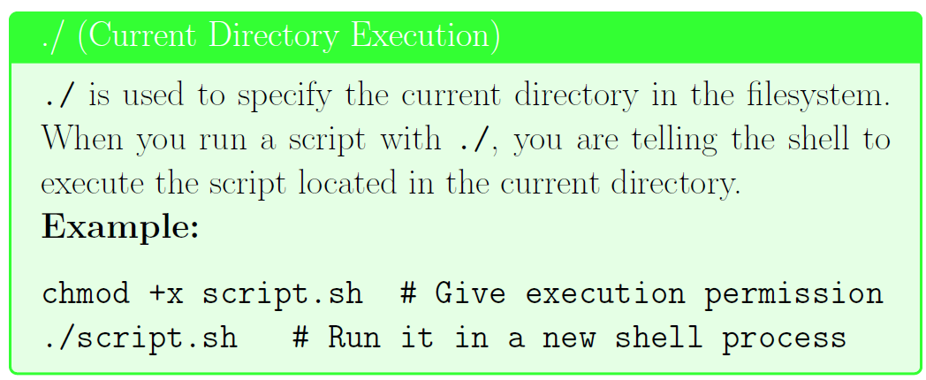
Understanding “.” “./” and “. ./” in Shell

Slide 28
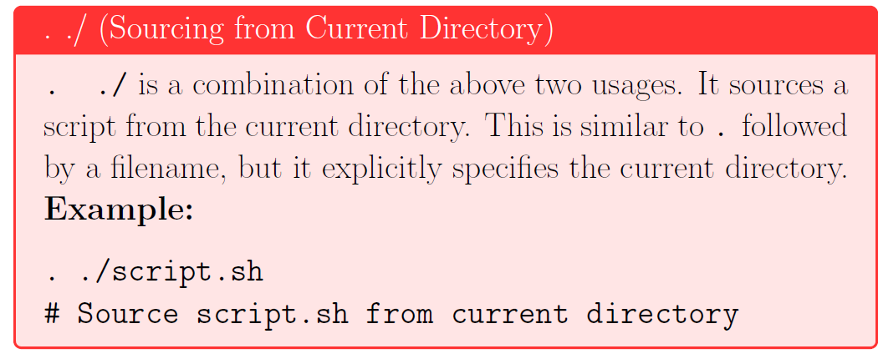
Understanding “.” “./” and “. ./” in Shell

Slide 29
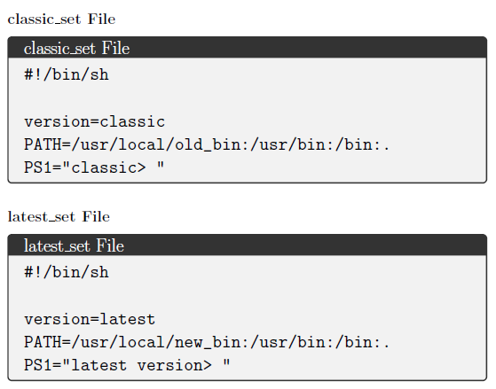
Setting up environment variables using . command
Suppose we have two files containing the environment settings for two different development environments.

Slide 30
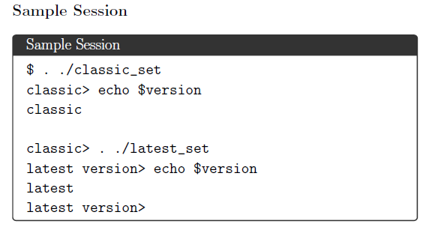
Changing Environment Settings (Cont..)

Slide 31
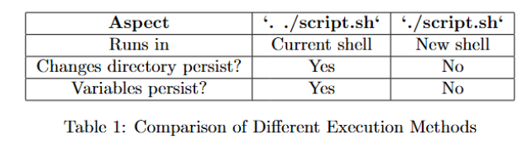
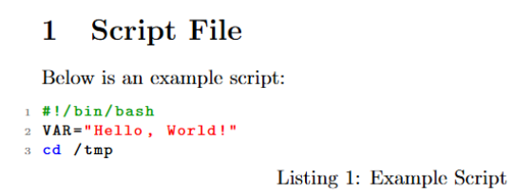
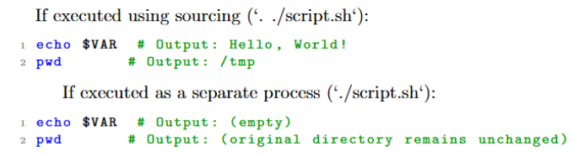
Example

Slide 32
Thank You
Questions?

